Slide 1
Cultural Anthropology
Ethnographic Methods

Slide 2
Event Description
The event was the annual African American dance
Different groups from all over the country presented their dance styles.
The winner would later be chosen by a select African American leaders.
Notes:
I attended an African American annual dance that is held in New York. The purpose of my attendance was to observe the event and also identify different dance groups from all over the country. I took a pen and a notebook just to write down my observations in a far corner of the mall. Different groups from all over the country presented their dance styles.
The winner would later be chosen by a select African American leaders.

Slide 3
Tools used
Drums of different sizes
A guitar
A Trumpet made of horn
Notes:
There are no complicated tools in the African American dance setting. The main elements observed are drums of different sizes, a guitar and also a trumpet made of horn. These are different elements that are used to demonstrate that the African American community is rich in their own culture.

Slide 4
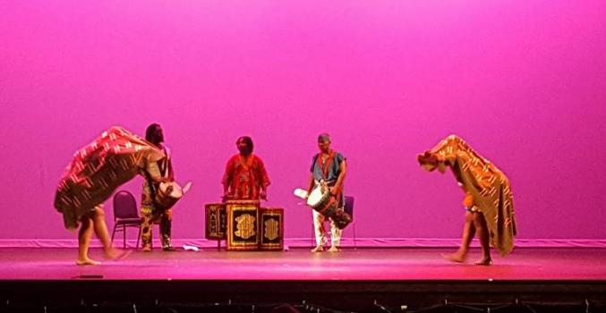
Drum set
Notes:
This is a typical drum set with dancers who follow the beats from the drum set. This is the most common element that I observed with the African American communities.

Slide 5
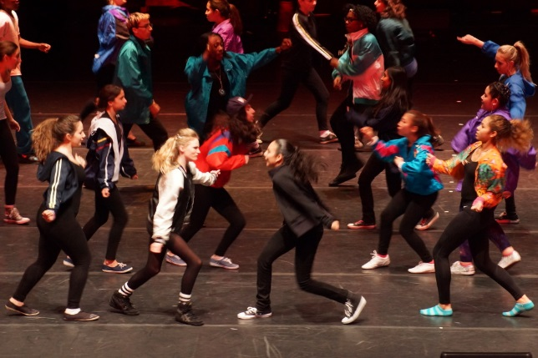
Dance Styles
Notes:
This is an image I took that demonstrates how the dances would dance in circles while following a leader at the center. They would encircle the man who held a trumphet and would dictate the rhythm and the style.

Slide 6
Steps in the dance
The men would lead the dance and the women would follow.
At some point in the dance, there was also a line formation that was led by a man.
The men would improvise new styles that followed the rhythm of the dance and women would completely follow up.
Notes:
The men would lead the dance and the women would follow. At some point in the dance, there was also a line formation that was led by a man. The men would improvise new styles that followed the rhythm of the dance and women would completely follow up. There was also participation of the community in the dance and this would clearly be proven by the men who would be involved in dance. It seemed that the men and women would be competing at some point in terms of their voices and also their mannerisms.

Slide 7
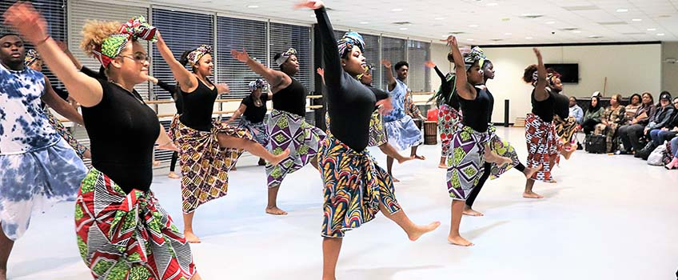
Group of women competing
Notes:
This is an image I also took on the group of women who would showcase different styles in the flour.

Slide 8
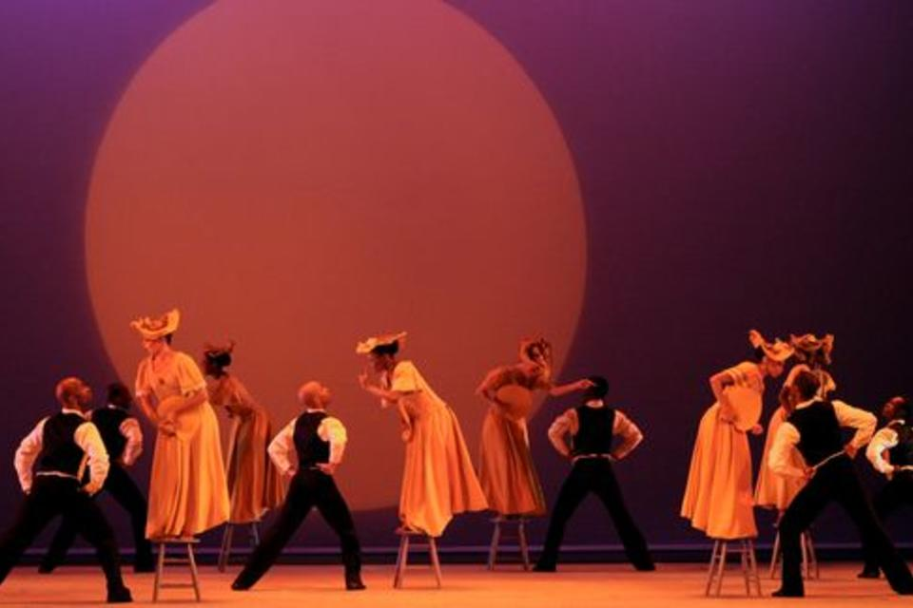
African American dancers
Notes:
I took this picture to showcase the image of a group of men who seemed to be dictating the direction in which the dance was taking place and the direction of the movements being conducted.

Slide 9
Non verbal elements
Increased hand gestures and locomotion
The emotion changes from sad to happy depending on the story
There is increase eye contact
The touch is minimal
Notes:
The African American dance seems to be unique one. This is because it incoperates different non verbal elements such as increased hand gestures, locomotion, minimal touch, increased eye contact, change of emotions and also increased locomotion.

Slide 10
Forms of the event
Most of the steps involved in the dance included increased forms of jumping, scuffing and also hopping
There is improved conversation and also movements that are aimed at making the dance more unique and in circular movement.
The dance has also elements such as increased forms of reprocicity that are evident among the dancers who make similar movements that tend to attract the attention of the viewers.
Notes:
Most of the steps involved in the dance included increased forms of jumping, scuffing and also hopping of steps to make a movement. This increased the level and manner in which the dance was performed. There is improved conversation and also movements that are aimed at making the dance more unique and in circular movement. The dance has also elements such as increased forms of reprocicity that are evident among the dancers who make similar movements that tend to attract the attention of the viewers. This has helped to create unique performances for all those involved in the competition. Men seem to be the leaders in the dance competition who make movements to attract followership.

Slide 11
Conclusion
In summation, at the end of every year, African American communities gather to showcase their cultural backgrounds.
They use dance as one of their main elements to described their complicated story.
The dance competition usually tries to tell a story of the competing males and female for dominance in the society.
Notes:
In summation, at the end of every year, African American communities gather to showcase their cultural backgrounds. This presentation details the dance styles, elements and also documentation of what happened in the African American stage where different elements of a story are told through the eye of the viewers. They use dance as one of their main elements to described their complicated story.
The dance competition usually tries to tell a story of the competing males and female for dominance in the society.

